Slide 1
Cradle Programmer User Manual
Document no: WT9584-i5
Issue date: 22 December 2022​

Slide 2
Contents
Introduction
Pre-requisites
Installation and activation
Initial setup
Parameter files
Firmware files
Configuration files
Programming screen
Offline behavior
Advanced instructions
  Set password
  Duplicate data warnings
  Lookup files
  Update cooler screen
  Full screen scanning confirmations
  Language settings
  Export/import programming configurations
  Batch programming
  Deactivation
Troubleshooting

Slide 3
Introduction - 1 of 4
AoFrio fitting within your manufacturing process
At AoFrio, we understand that each manufacturing process is unique to each manufacturer and even to a production line.
After visiting a fair few manufacturers, we have attempted to create a system and application that is flexible and configurable to fit your manufacturing process. With each new release we attempt to increase the functionality and flexibility of the Cradle Programmer, so that it gives each of our manufacturers the flexibility to produce equipment using SCS with minimal errors.
As you read through this guide, you will notice the instructions do not tell you how to do it, but rather shows you how each feature works. The intention is that your AoFrio representative will help tailor a process that fits with your manufacturing process using the functionality made available.
We are always looking for ways to improve and if you have any suggestions or requests please convey them to your AoFrio representative, who will bring them to the Product Team, where each request is reviewed and carefully considered, so we can define how and when to implement it.
We trust that you will find this manual helpful. If you require production line instructions documenting your unique use of the Cradle Programmer, please reach out to your AoFrio representative, who will be more than willing to help you.

Slide 4
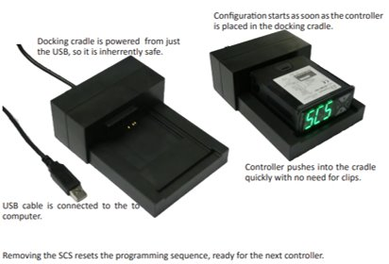
Introduction - 2 of 4
General
The Cradle Programmer is intended for original equipment manufacturers (OEMs) and has been designed to support the hardware piece (the “Docking Cradle”) which programs a SCS controller with the relational information between the equipment, controller, manufacturer and the owner of the equipment.
The programming process allows the configuration of the following items:
controller parameters;
controller firmware;
equipment model;
equipment serial number;
IDs: manufacturer, owner (bottler), and brand;
asset number.

Slide 5
Introduction - 3 of 4
1​ | Controller parameters​ | The variables that control the operation and behaviour of the equipment, such as temperature and time. Required to set up the controllers refrigeration algorithm and standby responses, as well as the specific input/output configuration of the controller.​ The parameters can be made specific to equipment model and owner allow you to tailor the equipment behaviour to meet your customer’s unique requirements.​
2​ | Controller firmware​ | The version of the embedded software that controls the operation of the equipment and what features will be available in the controller.​ Enables the use of versions that are specific to types of equipment by upgrading or downgrading versions to match requirements.​
3​ | Equipment model​ | The equipment model information is used to populate several other fields related to the unique performance of each variant. Enables service technicians and equipment manufacturers to control factory versions that can be restored if necessary. Allows owners to filter information based on equipment model, and used by automated fault detection algorithms that depend on equipment type, size, etc.​
4​ | Equipment serial number​ | The equipment serial number records equipment information into the controller, which is used for tracking and recording purposes, or often used as a unique identifier for each equipment unit. The value set at time of programming, although optional, is written into the controller.​
5​ | IDs: manufacturer, owner (bottler) ​and brand​ | The identifiers that associate the specific controller unit with its manufacturer, owner, and brand.​ Required to determine who has permission to access the controller and define the database where the collected data will be uploaded.​
6​ | Asset number​ | The unique identifier for the equipment that is recorded into the controller. All data associations and information are tied to the asset number, making the asset number and IDs the most important information to be programmed into the controller.​ Although a manufacturer configuration process can proceed without setting an asset number, this is strongly discouraged as no reporting or asset tracking will take place until the asset number is set.​

Slide 6
Introduction - 4 of 4
Configuration time
Configuration time is dependent on the items being set at time of programming.
When setting the below items, configuration takes less than 30 seconds per controller:
controller parameters;
IDs: manufacturer, owner (bottler) and brand;
equipment model;
equipment serial number;
asset number.
If controller firmware needs to be programmed, in addition to the above items, configuration time is extended to approximately 50-60 seconds per controller.

Slide 7

Pre-requisites – 1 of 2
To have your Cradle Programmer run successfully, the following components are required.
Hardware
Ensure you have been supplied with a physical Docking Cradle. If one is required, please contact your AoFrio representative.
Barcode scanner, if required by your production process. A barcode scanner can be used to do the following:
  change the configuration file on the programming page of the Cradle Programmer;
  scan the asset details, being any of the following:
    equipment serial number;
    asset number;
    compressor serial number.
Laptop/PC with available internet connection and USB ports for the Docking Cradle and barcode scanner.
If a barcode scanner is used, it must be set to keyboard entry with carriage return.

Slide 8
Pre-requisites – 2 of 2
Before starting
Obtain the downloadable link for the Cradle Programmer installation file and an activation code for the app from your AoFrio representative. The system has controlled access, so please communicate with your AoFrio representative if additional permissions are needed.
Please ensure the correct firmware version is being used to program the SCS controller. If confirmation is needed, contact your AoFrio representative.
Ensure your research and development team or lab technicians have created the required parameter files via the AoFrio Lab application and made them available in the Cradle Programmer. These must be uploaded to the AoFrio Cloud (server) for the cooler models being manufactured with any AoFrio SCS controller models. Refer to the parameter file section of this manual.
Ensure your manufacturing or production managers have created the appropriate equipment model options using the OEM Dashboard application and made them available to required owners. Refer to the parameter file section of this manual.

Slide 9

Installation and activation – 1 of 2
Installation process
Obtain the link to download the (*.exe) installation file for the latest Cradle Programmer from your AoFrio representative.
Click on the link to start downloading.
When the download has completed, navigate to the file on your local PC/laptop.
By default, files are saved to the Downloads folder.
Double click on the file to start installation process and follow all onscreen instructions.
If an older version of Cradle Programmer is currently installed on the local PC/laptop, you will be prompted to replace the old version with the new one during installation process.
The Cradle Programmer will start automatically, upon successful installation/update.

Slide 10
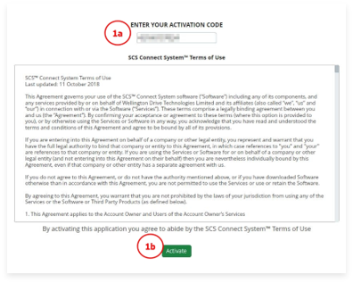
Installation and activation – 2 of 2
Activation process
A stable internet connection is required for activation.
When you first start the Cradle Programmer you will be requested to enter your activation code.
1a. Enter ACTIVATION CODE in the box.
1b. Click ACTIVATE.
Please contact your organization’s user manager to receive an activation code.

Slide 11
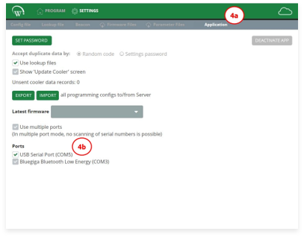
Initial setup
The first step of the programming process requires initiating connection between the hardware Docking Cradle and the software Cradle Programmer.
Select the PC/laptop that will be used in the production process.
Connect the Docking Cradle to the selected PC/laptop using the USB cable provided with the hardware.
Open the Cradle Programmer, which has been previously activated per installation and activation instructions.
Select the USB port for the connection between the docking cradle and the PC/laptop to be established.
4a. Navigate to the SETTINGS tab, then access the APPLICATION submenu.
4b. In the PORTS section, select the appropriate USB Serial Port (COM#).
If the target USB port is not visible, please disconnect the USB cable from the Docking Cradle from your computer and connect it to a different USB port. Restart the Cradle Programmer.

Slide 12
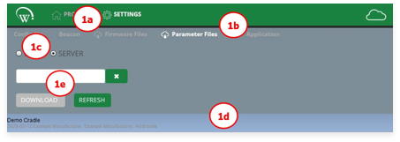
Parameter files
When required for your manufacturing process, pre-defined parameter files should be imported from the server.
The parameter file contains all the individual parameters selected for a specific equipment model and owner, and it is created and uploaded to the AoFrio Cloud (server) by your research and development team or lab technicians using the AoFrio Lab application.
If a parameter file is not visible to you, please contact your AoFrio representative, as the right permissions are required.
Always ensure the correct parameter file is being used.
Download the required parameter files
1a. Navigate to the SETTINGS tab.
1b. Access the PARAMETER FILES submenu.
1c. Select SERVER.
1d. Select the desired parameter file from the list shown or use the search bar.
1e. Click DOWNLOAD to save the selected parameter file.

Slide 13
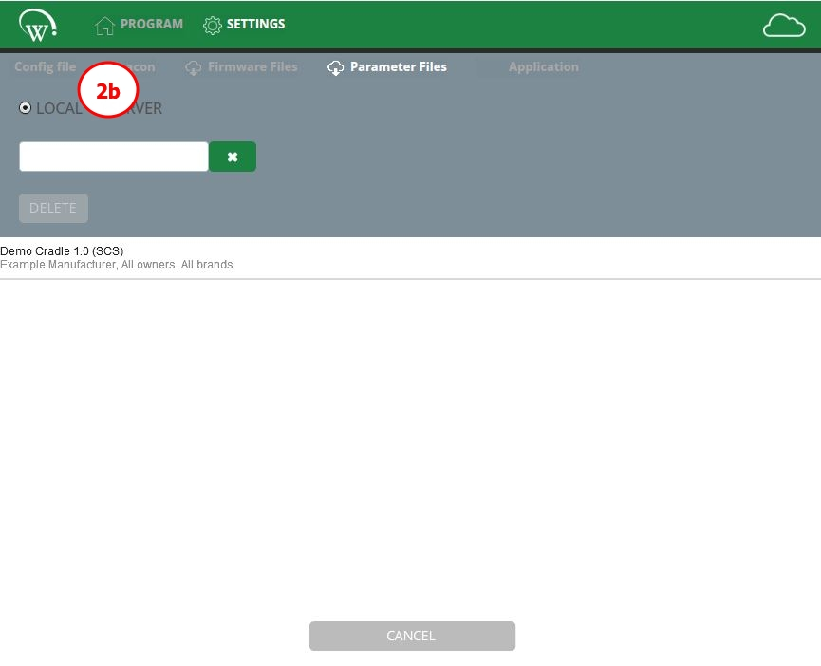
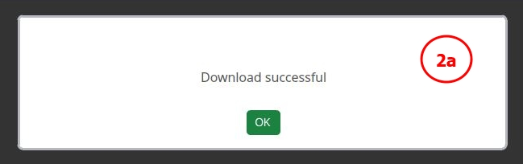
Parameter files continued
Validate the parameter file has been downloaded successfully
2a. A message about successful download will be shown.
2b. Downloaded parameter files are visible under the LOCAL tab.
All the parameter files listed under the LOCAL tab will be visible in the parameter file drop down selection for the configuration file or lookup file sections of this user manual.

Slide 14
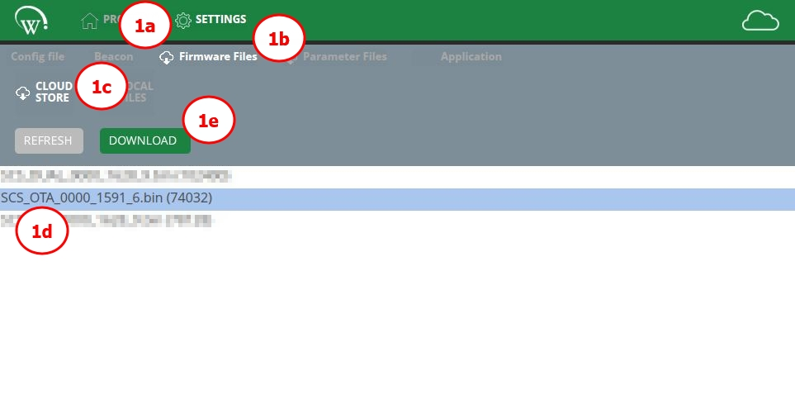
Firmware files
The Cradle Programmer allows the controller firmware to be updated during the programming process. This, however, should only be done on an as-needed basis.
It is highly recommended to use the latest firmware version when programming AoFrio SCS controller, as constant improvements and new features are added, providing the best opportunity to ensure your equipment will operate as expected.
Please ensure the user permissions associated with your role include firmware file download, as set by your organization’s user manager. The required firmware version must be released to your database in the AoFrio Cloud (server) prior to the programming process.
Download the required firmware file from the server
1a. Navigate to the SETTINGS tab.
1b. Access the FIRMWARE FILES submenu.
1c. Select SERVER (or CLOUD STORE, depending on your software version).
1d. Select the required firmware file by clicking on it, the file will be highlighted.
1e. Click DOWNLOAD to save the selected firmware file.

Slide 15
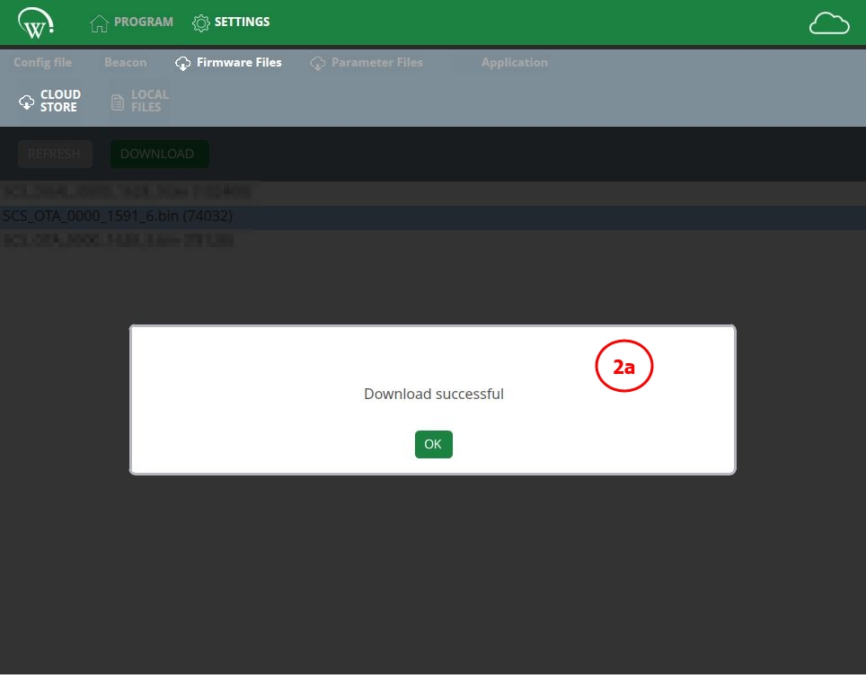
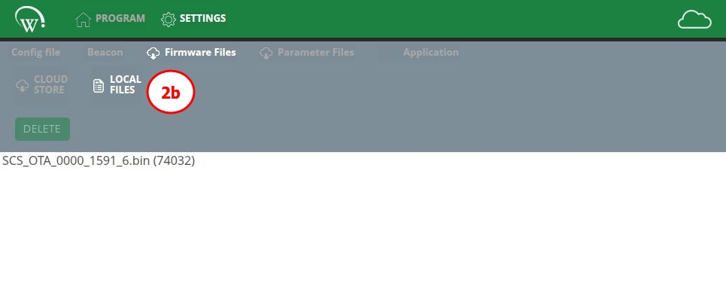
Firmware files – 1 of 2
Validate the firmware file has been downloaded successfully
2a. A message about successful download will be shown.
2b. Downloaded firmware files will now be visible under the LOCAL FILES, or under the LOCAL tab depending on your software version.
All the firmware files listed under the LOCAL tab will be visible in the firmware drop down selection for the configuration file or lookup file, which is used to define which version will be used during programming.
It is recommended that only the necessary files be kept in LOCAL storage to avoid confusion and potential for errors.

Slide 16
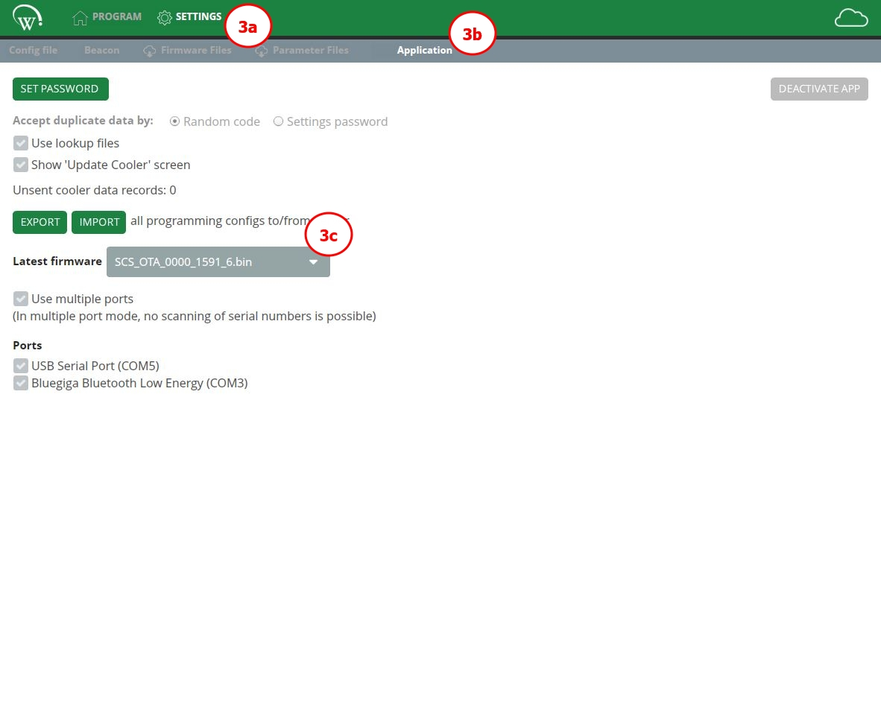
Firmware files – 2 of 2
Define latest firmware
One of the firmware files listed under the LOCAL tab may be defined as the latest firmware. This selection associates a firmware version to be installed when the latest firmware option is selected from the dropdown list at the time of programming.
3a. Navigate to the SETTINGS tab.
3b. Access the APPLICATION submenu.
3c. From the LATEST FIRMWARE dropdown, select the appropriate version.

Slide 17
Configuration files – 1 of 15
The Cradle Programmer allows you to create configuration files to be used in production.
These are intended to facilitate selection during production and can be made to manage specific equipment model, owner, firmware version, or more. The selection of the available components is dependent on the way the configuration file is set.
The creation of configuration files should be done by (or in collaboration with) the appropriate manufacturing or production managers in your organization as it strongly impacts the equipment production process.

Slide 18
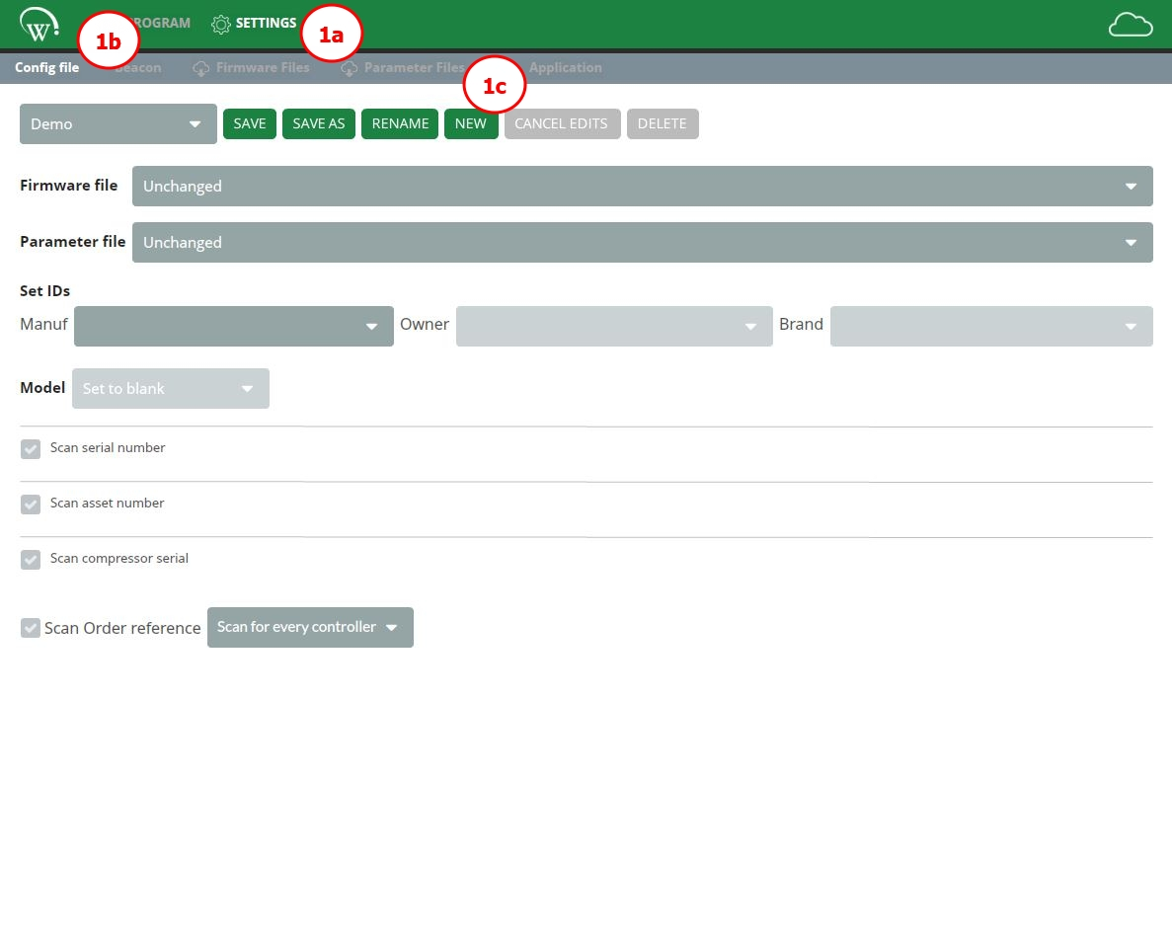
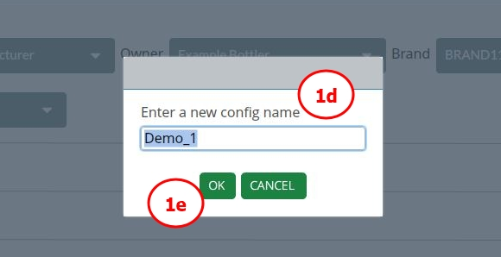
Configuration files – 2 of 15
Create a configuration file
1a. Navigate to the SETTINGS tab.
1b. Access the CONFIG FILE submenu.
1c. Select NEW.
1d. Enter a NAME for the new configuration file.
1e. Select OK to proceed.

Slide 19
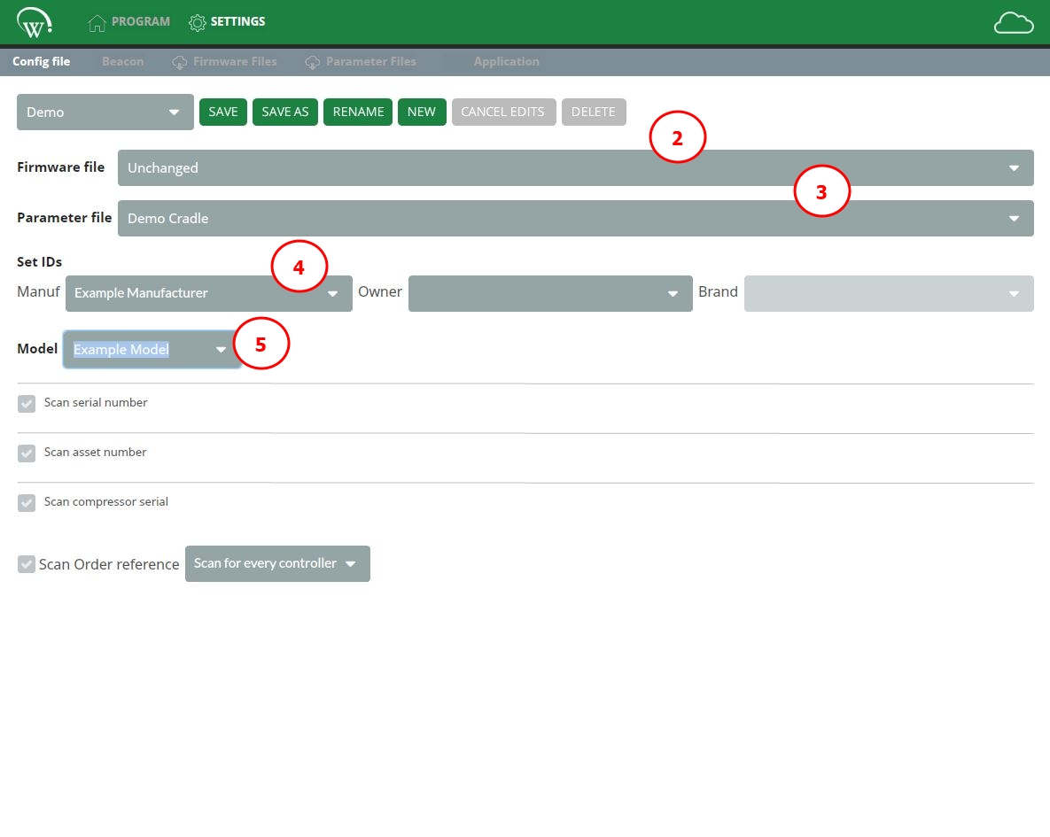
Configuration files – 3 of 15
Select a firmware file
If desired, select the appropriate firmware file to use in this configuration file.
A firmware file does NOT have to be specified. It may be set to UNCHANGED or set to the pre-defined LATEST FIRMWARE.
- UNCHANGED: the firmware will not be updated, and the version installed in the SCS controller at the time of programming will be used.
- LATEST FIRMWARE: the version configured as the latest firmware will be used (see STEP 3 in the firmware files section).

Slide 20
Configuration files – 4 of 15
Select a parameter file
If required, select the appropriate parameter file to use for this configuration file.
Instructions on how to download a parameter file can be found in the parameter files section of this manual.
- If no parameter file is chosen, the controller will be programmed with the factory default parameters defined by the firmware version.
- If factory default is chosen, any customized parameters will be cleared from the controller memory and replaced with the AoFrio-provided defaults. All lifetime data collected by the controller (statistics, events, etc.) is also cleared to ensure there is no dependency on the device history.
Set IDs
Select manufacturer, owner, and brand to determine which companies are allowed to connect to the controller and define the database for all data to be uploaded.
Manufacturer field is required.
Owner field can be set to undefined, although this is NOT RECOMMENDED.

Slide 21
Configuration files – 5 of 15
Setting up the owner field during programming is HIGHLY RECOMMENDED. Leaving it blank makes the controller unable to track by the owner (or bottler) until properly configured.
If necessary to proceed without configuring the owner field at time of manufacturing, please speak to your AoFrio representative. There are several consequences and processes that must be discussed.
Brand field is optional and can only be set when an owner has been selected.
  Every brand is linked to an owner. Brands allow owners to create subdivisions within their own database to control access to data via Field app and Insights app, without impacting their ability to collect Bluetooth data via AoFrio Track application or SDK.
IDs in parameter files
Parameter files may already have pre-defined IDs, which will be used when programming the controller. If a value is NOT previously set within the parameter file, or a parameter file was not selected, the permissible values will be selectable from the dropdown lists under Set IDs.

Slide 22
Configuration files – 6 of 15
Set model
Use this field to select the model of the equipment into which the controller will be installed.
If the appropriate equipment models are unavailable in the dropdown list, please contact the manufacturing or production manager in your organization, as these need to be predefined using the OEM Dashboard application.
Models in parameter files
Parameter files may already have a pre-defined model, which will be used when programming the controller. If a value is not previously set within the parameter file, or a parameter file was not selected, the permissible value will be available to select from the dropdown list.

Slide 23
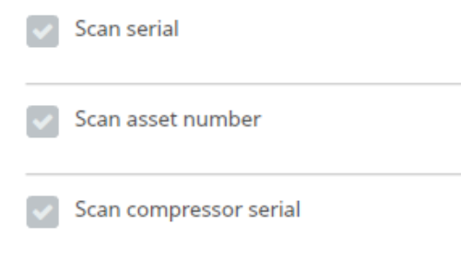
Configuration files – 7 of 15
Scan configuration – setting the asset details
To make equipment manufacturing faster and less error prone, scanned data can be used to program the equipment information.
There are three options:
Scan serial – the equipment serial number.
Scan asset number – the unique number used for asset identification by the equipment owner.
Scan compressor serial – the unique number associated with the compressor when compressor matching is required.
When these options are selected, the information must be scanned for the controller to be programmed.
The following scanned information is recorded into the controller: the equipment serial number, the unique asset number, and the equipment model, the manufacturer and owner references to control who has access to the controller. All scanned information is also stored in the AoFrio Cloud (server) where the unique equipment record is created, allowing programming data to be collected.

Slide 24
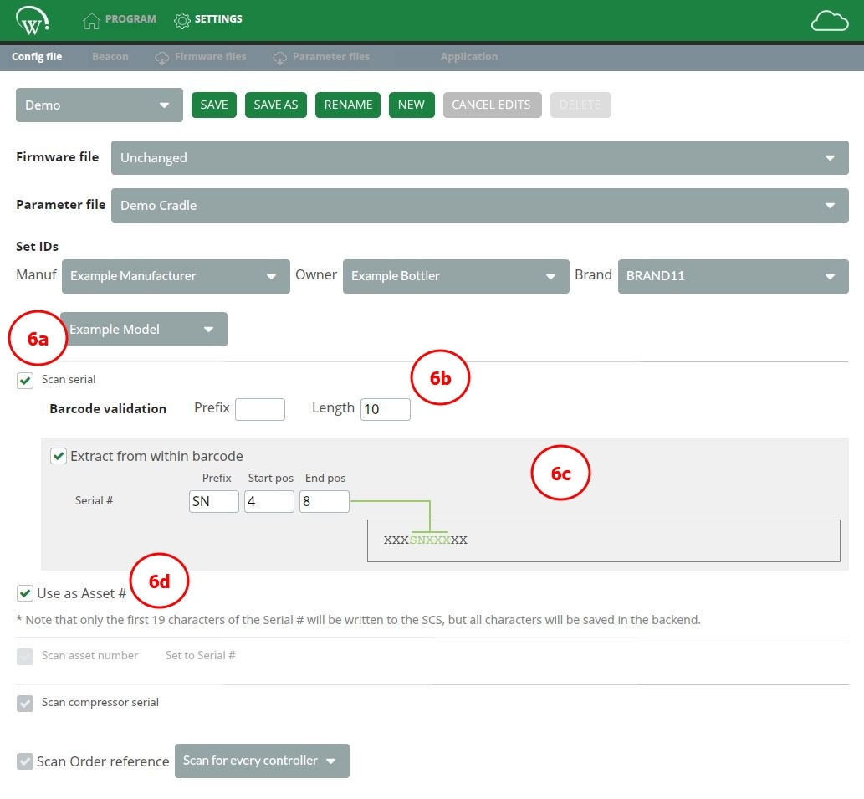
Configuration files – 8 of 15
6.1 Scan serial
6a. Select SCAN SERIAL tick box.
This will request a barcode with the appropriate equipment serial number to be scanned during the controller programming process in the equipment production line.
It is highly recommended for the equipment serial number to be programmed into the controller. This allows an owner (bottler) to identify the equipment unit by its serial number in all AoFrio reporting applications.
6b. Specify BARCODE VALIDATION rules (optional).
You can set prefix and/or length parameters to validate the type of barcode that is supposed to be scanned in production. This ensures the operator is prompted to scan the correct information and reduces the potential for incorrect data to be programmed into the controller.

Slide 25
Configuration files – 9 of 15
6c. Select EXTRACT FROM WITHIN BARCODE (optional).
The scanned barcode may simply contain the equipment serial number or be used to convey additional information about the equipment and/or owner (bottler). This feature allows the identification of the equipment serial number within a more complex (longer) barcode, by selecting:
start position and end position;
(optional) prefix.
Both start position and end position must be specified for the “extract from within barcode” feature to function.
Example
The barcode is 10 digits long: BC1SN12388.
It contains the serial number SN123. To successfully extract this value upon barcode scan, please configure:
prefix (if applicable) – SN;
start position – 4, for the 4th digit of the barcode;
end position – 8, for the 8th digit of the barcode.

Slide 26
Configuration files – 10 of 15
6d. (Optional) Select the tick box for USE AS ASSET#.
When this option is selected, the equipment serial number will be used to configure both the serial number field and asset number field. Consequently, the “scan asset number” tick box will be grayed out and unavailable.
If the equipment serial number is longer than 19 characters, only the first 19 digits will be programmed to AoFrio SCS controller, but the full information will be saved in the AoFrio Cloud (server).
When the asset number is unknown, use of the “Use as Asset#” feature is highly recommended.

Slide 27
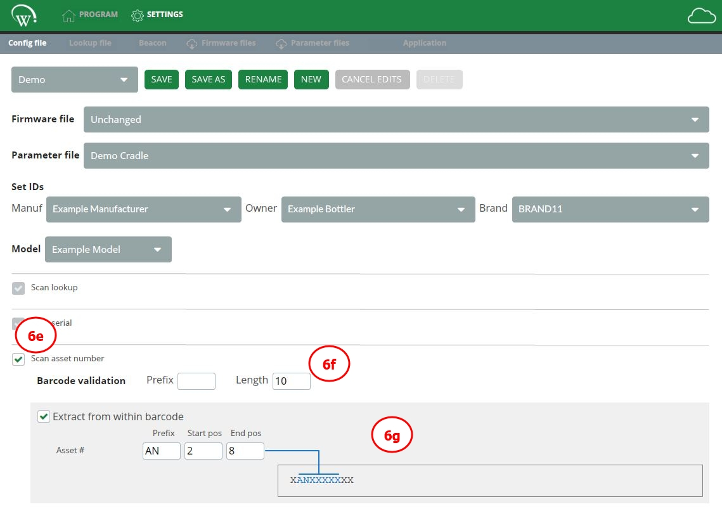
Configuration files – 11 of 15
6.2 Scan asset number
6e. Select Scan asset number tick box.
This will request a barcode with the appropriate asset number to be scanned during the controller programming process in the equipment manufacturing line.
It is crucial for an unique equipment-identifying value to be entered here. This is usually the owner’s asset number or the equipment serial number for each unique equipment unit.
If necessary to proceed without configuring the asset number field at time of manufacturing, please speak to your AoFrio representative. There are several consequences and processes that must be discussed.
6f. Barcode validation (optional).
You can set prefix and/or length parameters to validate the type of barcode that is supposed to be scanned in production. This ensures the operator is prompted to scan the correct information and reduces the potential for incorrect data to be programmed into the controller.

Slide 28
Configuration files – 12 of 15
6g. (Optional) Select the tick box for Extract from within barcode.
The scanned barcode may simply contain the asset number or be used to convey additional information about the equipment and/or owner (bottler).
This feature allows the identification of the asset number within a more complex barcode, by selecting:
start position and end position;
(optional) prefix.
Both start position and end position must be specified for the “extract from within barcode” feature to function.
Example
The barcode is 10 digits long: BAN12345CD.
It contains the asset number AN12345. To successfully extract this value upon barcode scan, please configure:
prefix (if applicable) – AN;
start position – 2, for the 2nd digit of the barcode;
end position – 8, for the 8th digit of the barcode.

Slide 29
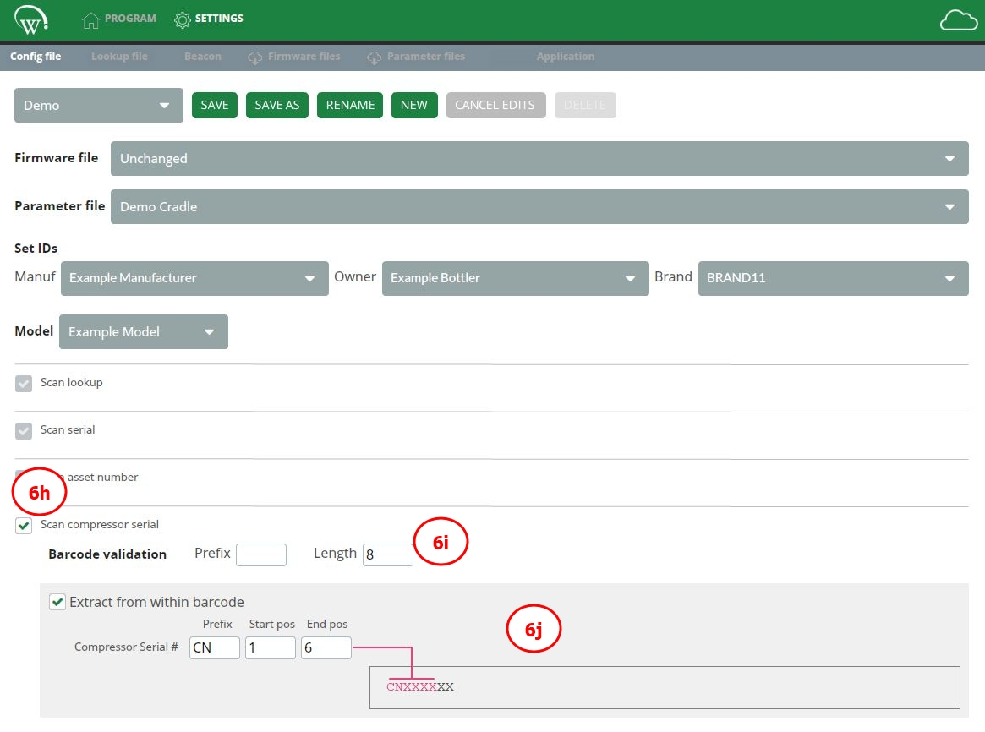
Configuration files – 13 of 15
6.3 Scan compressor serial number
6h. Select SCAN COMPRESSOR SERIAL tick box.
This will request a barcode with the appropriate compressor serial number to be scanned during the controller programming process in the production line.
6i. Barcode validation (optional).
You can set prefix and/or length parameters to validate the type of barcode that is supposed to be scanned in production. This ensures the operator is prompted to scan the correct information and reduces the potential for incorrect data to be programmed into the controller.

Slide 30
Configuration files – 14 of 15
6j. Extract from within barcode (optional).
The scanned barcode may simply contain the compressor serial number or be used to convey additional information about the equipment and/or owner (bottler).
This feature allows the identification of the compressor serial number within a more complex barcode, by selecting:
start position and end position;
(optional) prefix.
Both start position and end position must be specified for the “extract from within barcode” feature to function.
Example
The barcode is 8 digits long: CN123488.
It contains the compressor serial number CN1234. To successfully extract this value upon barcode scan, please configure:
prefix (if applicable) – CN;
start position – 1, for the 1st digit of the barcode;
end position – 6, for the 6th digit of the barcode.

Slide 31
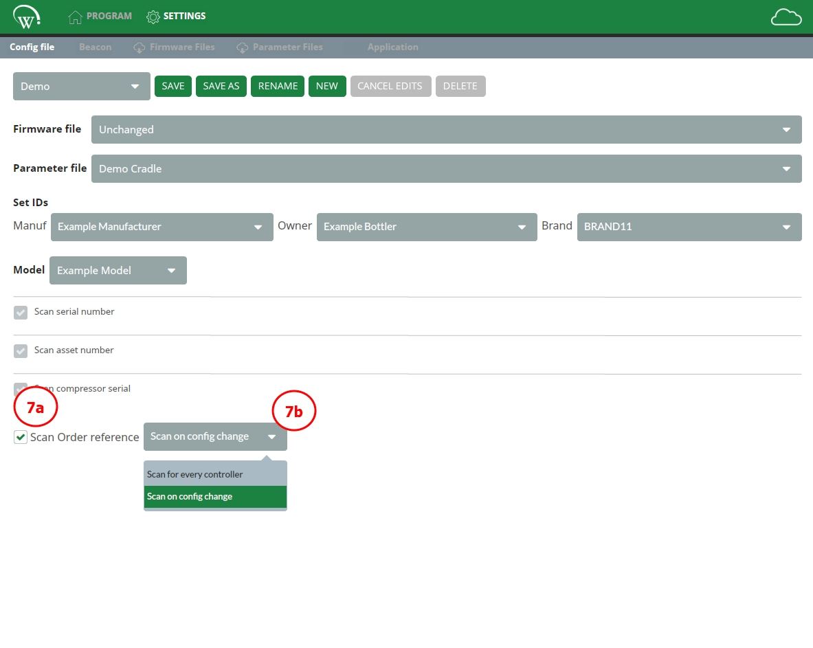
Configuration files – 15 of 15
Scan order reference
Depending on your production process, you may need to choose the “scan order reference” to ensure the information from the scanned barcode is correctly associated with the equipment.
7a. Enable SCAN ORDER REFERENCE function.
7b. Select one option from dropdown as shown below.
SCAN FOR EVERY CONTROLLER: | Requires barcode scans for every new controller placed into the Docking Cradle.
SCAN ON CONFIG CHANGE: | Requires barcode scans each time the configuration file is changed.

Slide 32
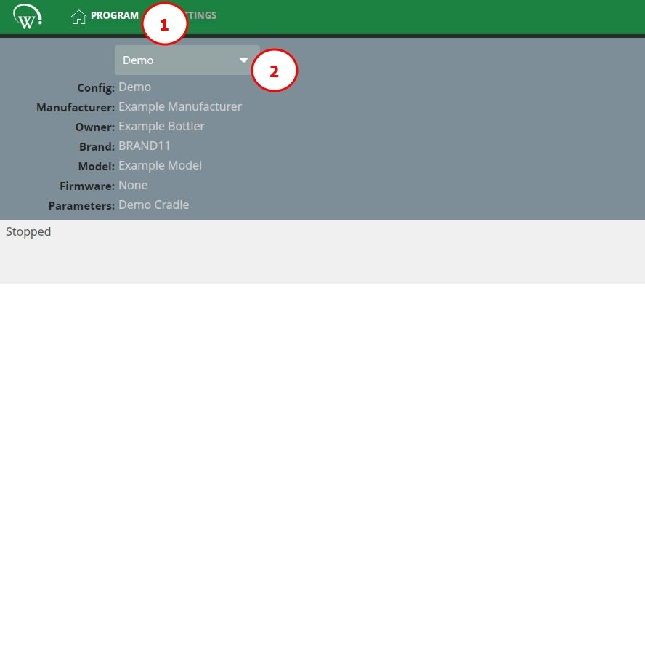
Programming screen – 1 of 3
To program the AoFrio SCS controller, please follow the steps below.
Navigate to PROGRAM tab.
Select the appropriate configuration file from the drop-down menu.
Only previously created and saved configuration files will be visible in the drop-down selection.
The name of the configuration file and all the associated information will be shown in the programming screen.
Configuration file scanner feature
A configuration file can also be selected by scanning a barcode containing the configuration file name.
To generate the barcode, visit any barcode generating website, type in the desired configuration name and a barcode will be generated. This can be printed and made available to the programming staff.
Scanning the barcode with the configuration file name will switch programming configurations accordingly.
This feature will only work if there is no controller in the Docking Cradle.

Slide 33
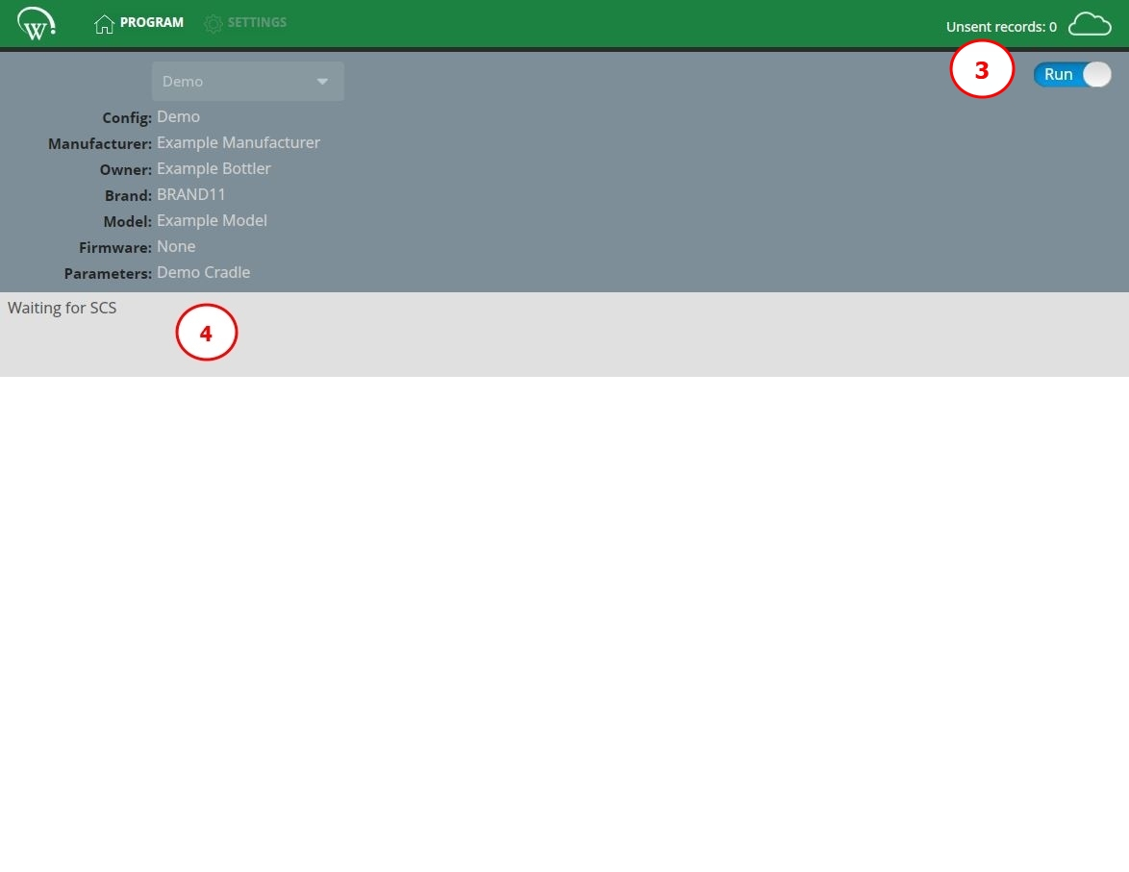
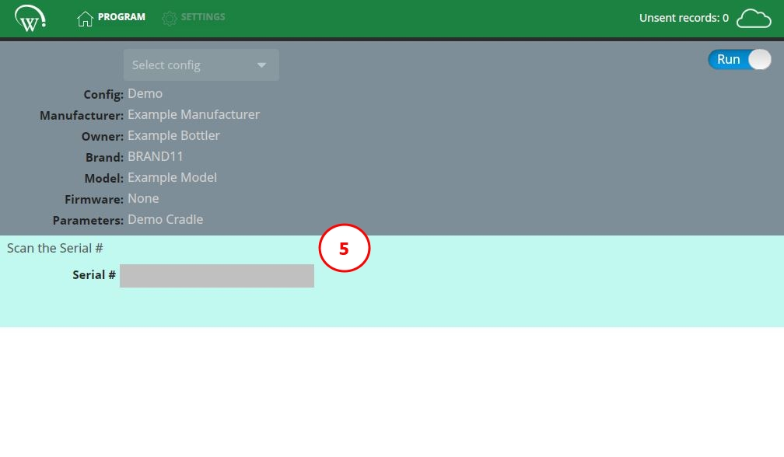
Programming screen – 2 of 3
Set from Stop to Run by clicking on slider.
Navigation to the other tabs is disabled while the slider is set to Run.
The Cradle Programmer will be Waiting for SCS to be placed into the Docking Cradle.
Place the SCS controller into the Docking Cradle.
If a SCS controller is NOT detected in the Docking Cradle during programming, the Cradle Programmer will return to this step.
Follow all on-screen input requests.
The detailed steps will depend on the configuration file setup. User instructions and input are provided in the mint shaded banner.
This screen will only be shown after a SCS controller has been detected in the Docking Cradle.
Barcode scanner MUST be set to keyboard entry with carriage return.

Slide 34
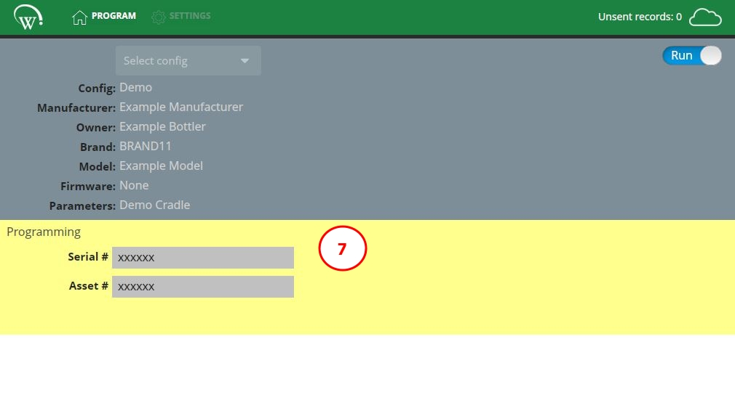
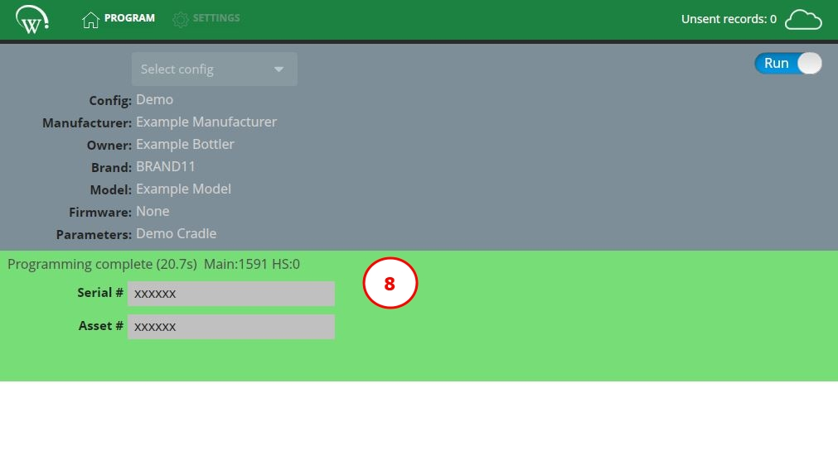
Programming screen – 2 of 3
Programming in progress
Programming automatically starts when all required details have been successfully entered. The banner color will change to yellow during configuration.
Programming complete
When programming of the SCS controller is completed, a status message is shown, and the banner color changes to green.
Please remove the SCS controller from the Docking Cradle. The Cradle Programmer will instantly go back to “waiting for SCS” state, per step 4.

Slide 35
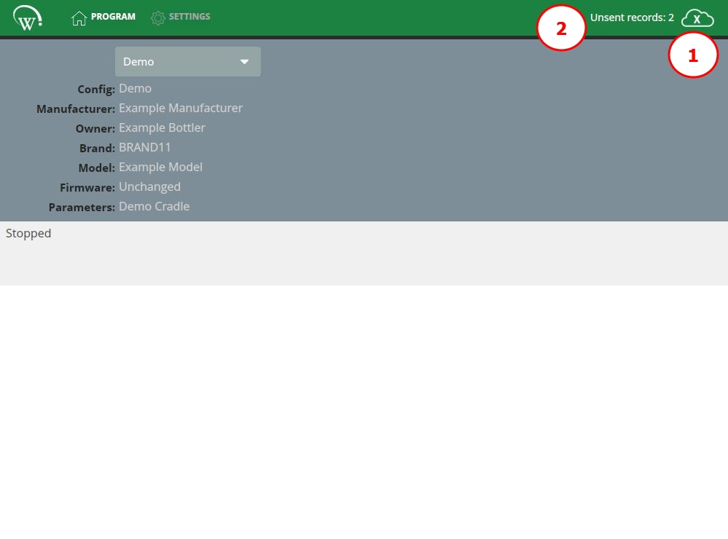
Offline behaviour – 1 of 2
Continuous internet connection is an important component in the programming process through Cradle Programmer, as it ensures the latest versions are always available and allows the software to upload all the information about programmed controllers and equipment records to the AoFrio Cloud (server).
If the connection is lost during the programming process, however, the process will not be interrupted.
The Cradle Programmer was designed to continue operation with the locally saved copies of the firmware, parameter, and configuration files, while also locally saving the programming records until a successful internet connection is re-established.
When the PC or laptop with the Cradle Programmer is online (connected to the internet) records get uploaded to the server immediately at the time of programming.
Internet connection display icon.
If there is an X inside the cloud icon on the top right, the Cradle Programmer is offline.
A message displaying the number of unsent records stored on the local PC is also shown.

Slide 36
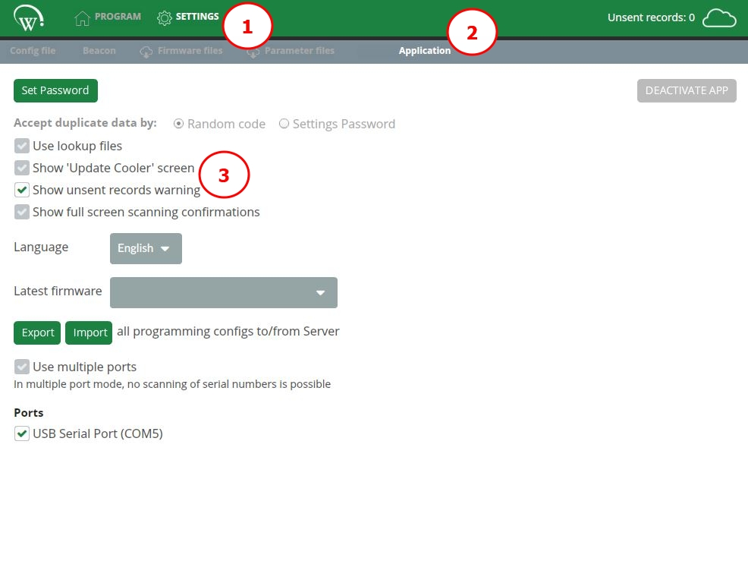
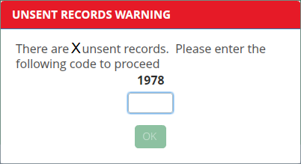
Offline behaviour – 2 of 2
Unsent records reminder feature
You may setup a reminder to display when 100 records have not been uploaded to the server.
The default number of unsent records is 100. This may be changed upon request to your AoFrio representative.
Navigate to the SETTINGS tab.
Access the APPLICATION submenu.
Select SHOW UNSENT RECORDS WARNING.
When this feature is used, the user will be presented with a warning that requires a randomly generated number to be typed to proceed with programming.
Please ensure to regularly connect your PC/laptop to the internet when the Cradle Programmer is running, allowing any unsent records to be uploaded to the server. Each record usually takes 2- 3 seconds to sync with the server.

Slide 37
Cradle Programmer
Advanced instructions

Slide 38
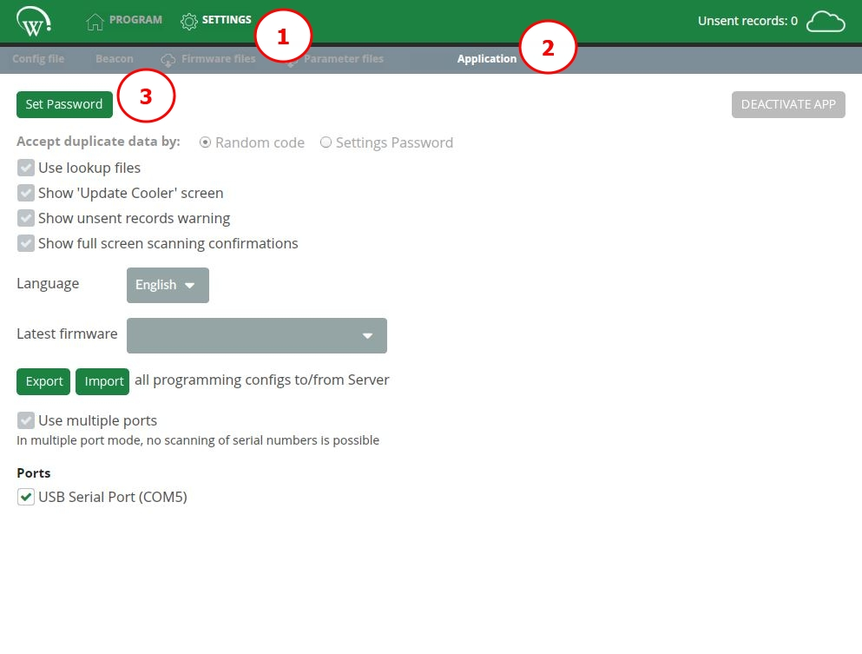
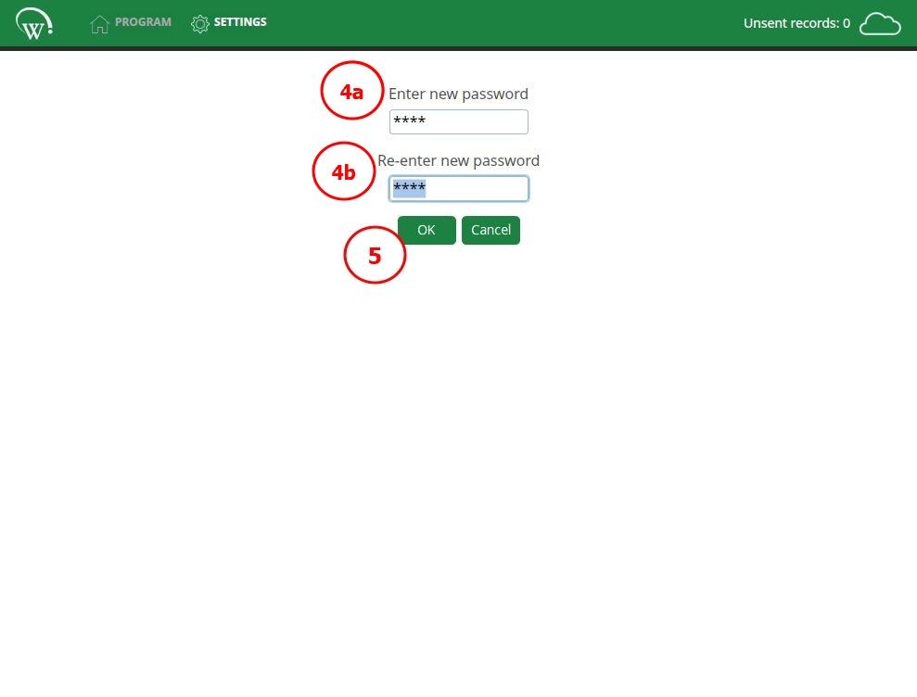
Set password – 1 of 2
Set password
For production environments, the Cradle Programmer allows the use of a supervisor’s password to limit the operator’s access within the application. When the password is set, an unauthorized user can only access the programming process portions of
the software.
Access to the settings screen and configuration file changes in the programming screen can only be unlocked by entering the correct password.
Navigate to the SETTINGS tab.
Access the APPLICATION submenu.
Click SET PASSWORD.
4a. Enter the PASSWORD.
4b. Re-enter the PASSWORD to reduce input error.
Select OK.

Slide 39
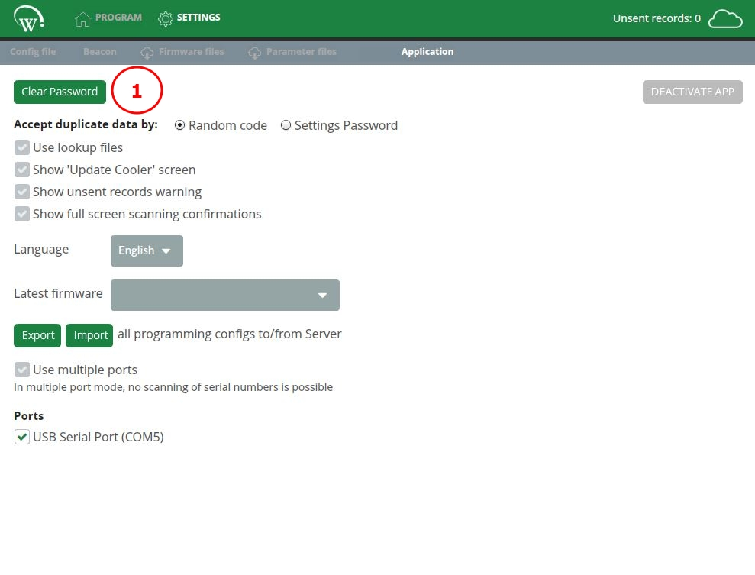
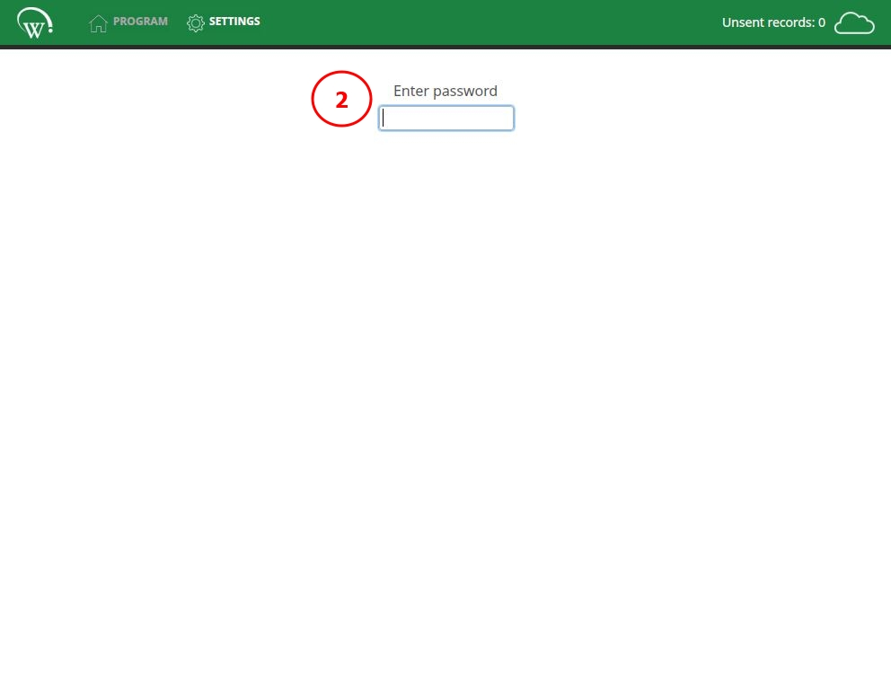
Set password – 2 of 2
Clear password
When a password is active, the previously shown ‘set password’ button will change to ‘clear password’.
Select CLEAR PASSWORD.
Enter your PASSWORD. Previous password is cleared out immediately.
If you forgot your password, please contact your AoFrio representative for instructions to reset it.

Slide 40
Duplicate data warnings – 1 of 2
As each AoFrio SCS controller unit is installed into equipment, the system needs to identify exactly which controller has been installed into each piece of equipment, making it imperative that the asset identifying information (asset number) be unique.
The Cradle Programmer should ONLY be allowed to program a duplicate asset number if a faulty controller was previously installed into the equipment unit and now must be replaced. In any other situations, the asset number MUST be unique.
Equipment manufacturing lines are busy places and errors can happen. To help reduce those errors, a warning message is presented to the operator (user) if a previously entered asset number has been used a second time.
This helps the operator validate that they are entering the correct information at time of manufacturing.
For this feature to successfully validate against all historical records, the PC/laptop must be connected to the internet during the programming process. If no internet connection is available, the Cradle Programmer only checks the entered data against the information locally cached in the PC/laptop.

Slide 41
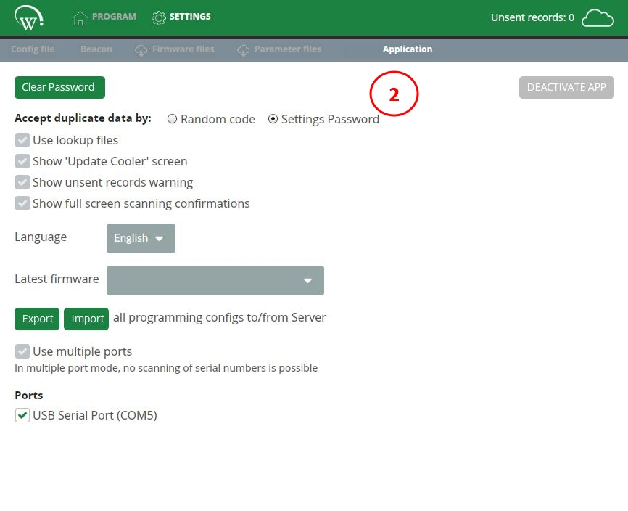
Duplicate data warnings – 2 of 2
Supervisor’s password setup
By default, Cradle programmer accepts duplicate data by typing the provided random code as acknowledgement of the duplication. If you wish to require a production supervisor’s password to accept duplicate data, please follow the steps below.
Configure a password to control access by following the set password instructions.
In the APPLICATION submenu, select the SETTINGS PASSWORD option.
The password required to accept duplicate data is the same as the one configured for access to settings, referred to as supervisor’s password.

Slide 42
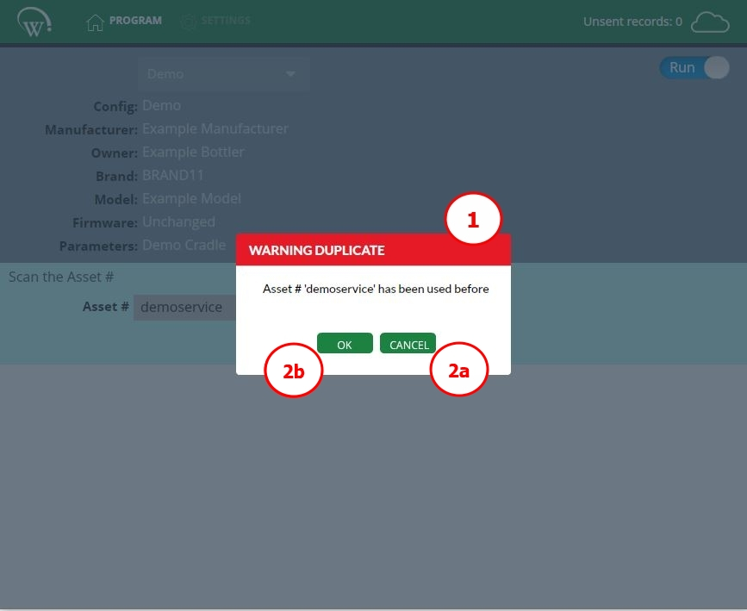
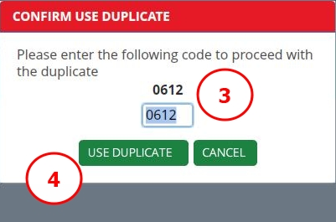
Duplicate data warning message
The pop-up error message notifies the operator (user) that the asset number was used before.
  2a. If the asset number entered was expected to be unique and was entered in error, select CANCEL to check the information entered. If you continue to receive this warning after checking the information entered, notify your production supervisor for assistance.
  2b. If the information entered was supposed to be a duplicate, select OK to proceed with programming of the duplicate asset number.
The Cradle Programmer should ONLY be allowed to program a duplicate asset number if a faulty controller was previously installed into the equipment unit and now must be replaced. In any other situations, the asset number MUST be unique.
Follow all on screen prompts (dependent on the app setup), and either enter the random code shown, or request the line supervisor to enter the PASSWORD.
Select USE DUPLICATE to proceed with programming of a repeated asset number.

Slide 43
Lookup files – 1 of 6
Lookup files allow the use of an entered or scanned value (the lookup input) to apply select configuration aspects from the corresponding lookup file for the programming of controllers.
They were designed to increase flexibility in a production line that either:
1. uses information embedded in a longer barcode to specify equipment model; or
2. have multiple pieces of information in a single barcode (such as asset number, equipment serial number and compressor serial number).
Values and configurations entered in the lookup file will overwrite those set in the configuration file.

Slide 44
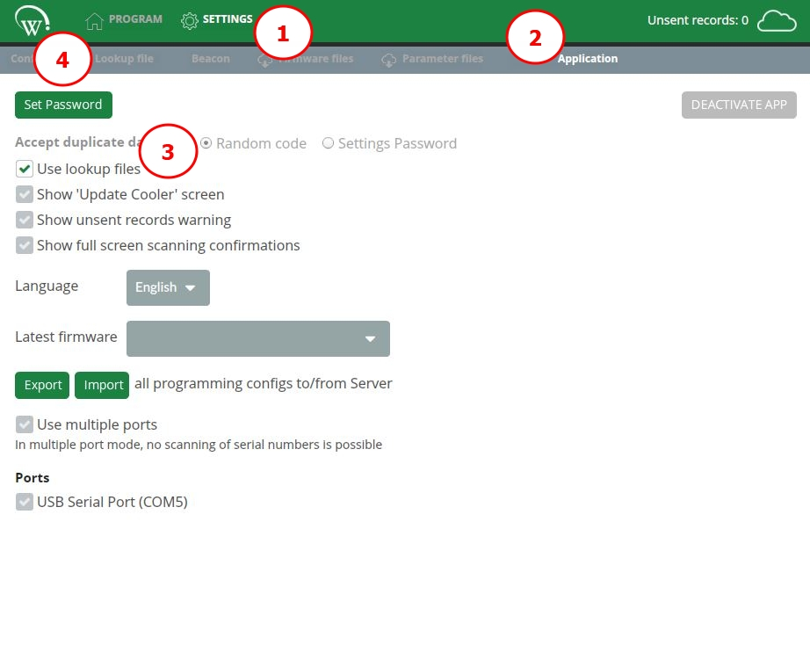
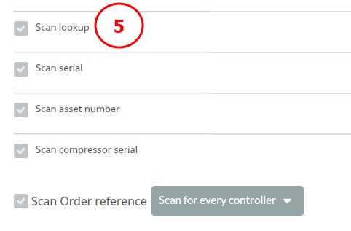
Lookup files – 2 of 6
Part 1: enabling lookup files
1. Navigate to the SETTINGS tab.
2. Access the APPLICATION submenu.
3. Select USE LOOKUP FILES tick box.
4. The LOOKUP FILE submenu will become visible.
5. A SCAN LOOKUP option will also now be available in the CONFIG FILE submenu.

Slide 45
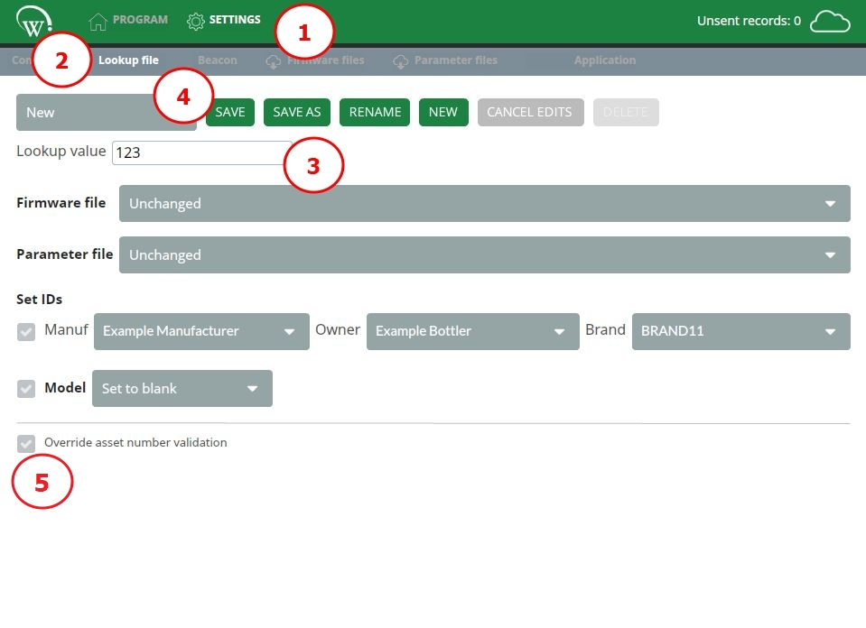
Lookup files – 3 of 6
Part 2: setting up a lookup file
1. Navigate to the SETTINGS tab.
2. Access the LOOKUP FILE submenu.
3. Specify the LOOKUP VALUE that will be entered to trigger the use of this lookup file configuration
4. Name the lookup file, using one of the options provided.
5. (Optional). If you are programming controllers for different owners that use a different asset number format, or otherwise operating in a mixed order production line, select the option to Override asset number validation.

Slide 46
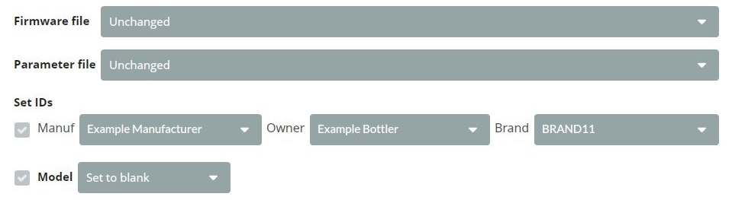
Lookup files – 4 of 6
Part 3: configuring lookup file settings
Select all required configuration options desired from the available drop-down menus and click SAVE.
More information on setting up firmware files and parameter files can be found in the appropriate sections of this manual.
Drop-down options
  - Unchanged: the file will not be updated, and the version installed in the AoFrio SCS controller at the time of programming will continue to be used.
- Latest firmware: the firmware version configured as the latest firmware will be used, per firmware files instructions.
- Factory default: the AoFrio-provided values for parameters, per configuration files instructions.
- Set to undefined: does not configure the field at time of controller programming. Acceptable for brand, NOT RECOMMENDED for owner.
- Set to blank: clears values previously set to the field, leaving it blank.
When lookup file is used, all information set in the lookup file will overwrite what is defined in the configuration file selected at time of programming.

Slide 47
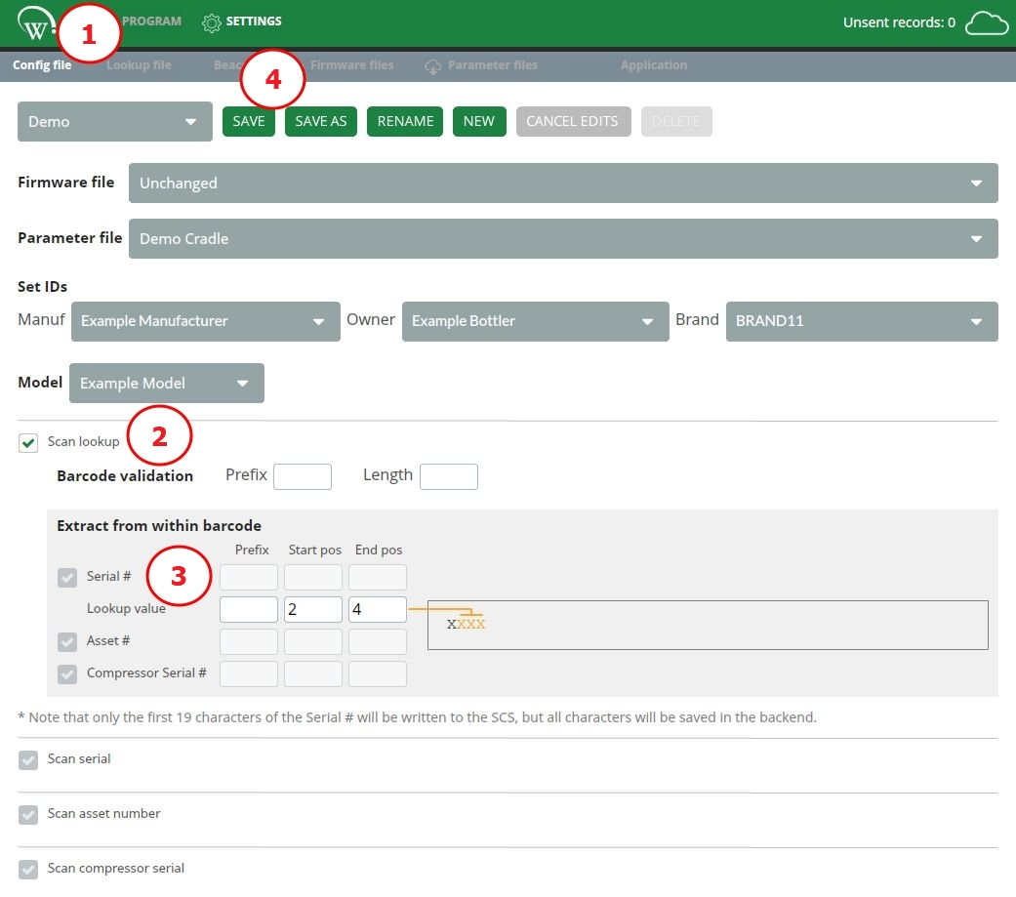
Lookup files – 5 of 6
Part 4: Allow lookup files from configuration file
To be able to select lookup files at time of programming, scanning a lookup file needs to be enabled for each configuration file that is intended to have a variation. If a configuration file, is not intended to be associated with a lookup file (does not have variations), the steps below can be ignored and the information in the configuration file will be programmed into the controller.
Access the CONFIG FILE submenu.
Select SCAN LOOKUP tick box.
For the LOOKUP VALUE within the barcode, specify:
  start position and end position;
  (optional) prefix.
Both start position and end position must be specified for the “extract from within barcode” feature to function.
Select SAVE.

Slide 48
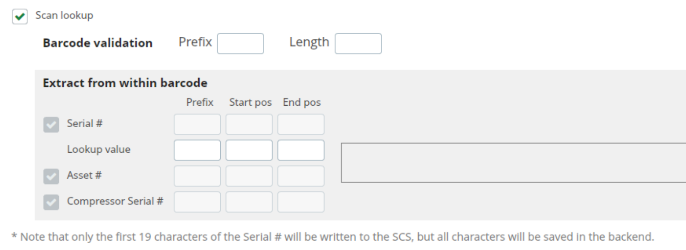
Lookup files – 6 of 6
Extract from within barcode
If your production line uses a single barcode to hold multiple pieces of identifying information (e.g., serial number, asset number, and/or compressor serial), you can use this functionality to extract this information.
Example
The barcode is 10 digits long: BC1SN12388.
It contains the serial number SN123. To successfully extract this value upon barcode scan, please configure:
prefix (if applicable) – SN;
start position – 4, for the 4th digit of the barcode;
end position – 8, for the 8th digit of the barcode.
This method to extract multiple pieces of information from a single barcode scan can be used even when no lookup value is to be entered or when lookup files are not used.

Slide 49
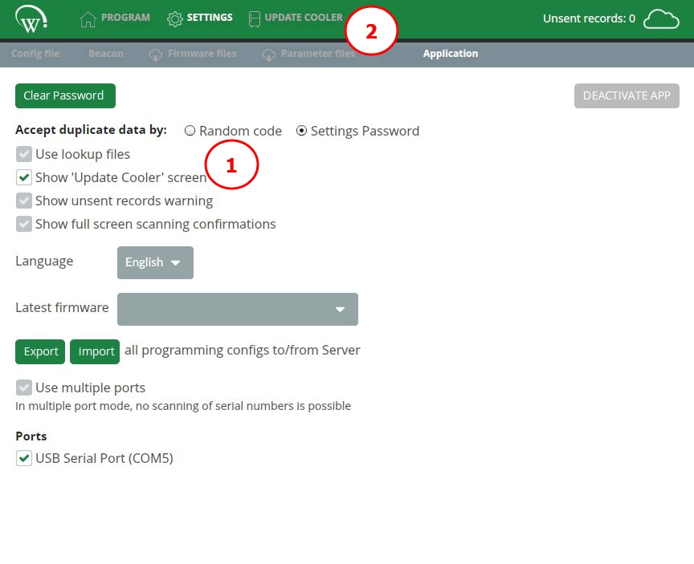
Update cooler screen – 1 of 5
Should the production process require information to be set after the controller has been programmed, or additional information for the equipment is required after the programming process is complete, it can be achieved through UPDATE COOLER screen.
Using this feature only updates information held on the server. Information held in the controller is NOT affected.
Part 1: enable UPDATE COOLER screen
UPDATE COOLER screen is disabled by default.
1. In the APPLICATION submenu, select SHOW ‘UPDATE COOLER SCREEN’ tick box.
2. The additional UPDATE COOLER tab will now be visible.

Slide 50
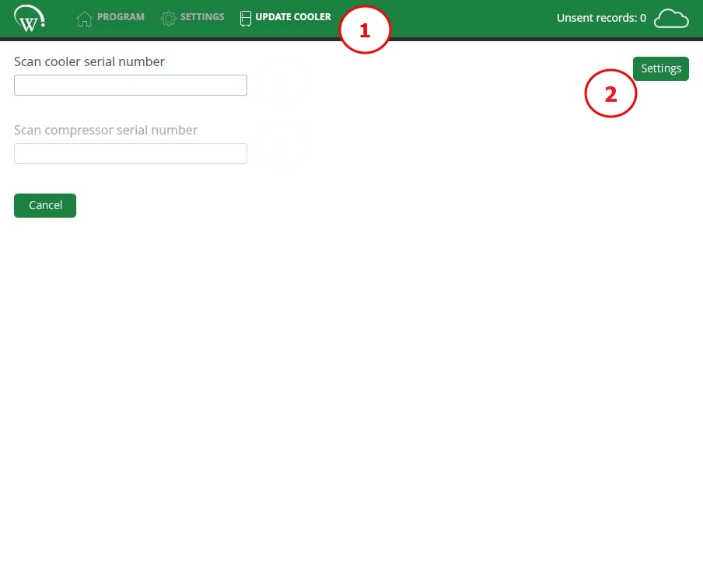
Update cooler screen – 2 of 5
Part 2: configure scan requirements
Navigate to the UPDATE COOLER tab.
Select SETTINGS to view configuration options.

Slide 51
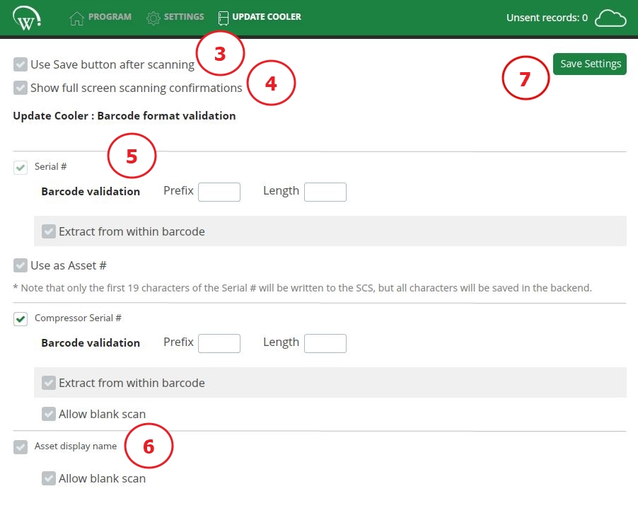
Update cooler screen – 3 of 5
(Optional). Select USE SAVE BUTTON AFTER SCANNING tick box.
By default, scanned values are saved automatically, however, you can configure the need to use a “Save” button to manually confirm the scan.
(Optional). Select SHOW FULL SCREEN SCANNING CONFIRMATIONS tick box.
A full screen notification will be presented for several seconds upon successful scanning. Details can be found in the full screen scanning confirmations section of this manual.
(Optional). Configured the desired scanning options.
Scanning options: detailed information on setting up equipment serial number and compressor serial number scans can be found in the configuration files section of this manual.
All data associated with the controller is saved against the equipment serial number entered, if the serial number is not valid, the system discards this information. It is imperative that the Cradle Programmer is connected to the internet to upload the manufacturing information for each controller programmed.

Slide 52
Update cooler screen – 4 of 5
(Optional). Asset display name - ALLOW BLANK SCAN
This feature will allow you to leave asset display name blank, when scanning additional information for cooler.
Select SAVE SETTINGS before exiting the screen.
Scanning additional information
Once the scan requirements for the UPDATE COOLER screen have been set, you can proceed with scanning the required information for each cabinet.
The required scan input will depend on your manufacturing process, follow all on screen prompts for entering the required information within the required box.

Slide 53
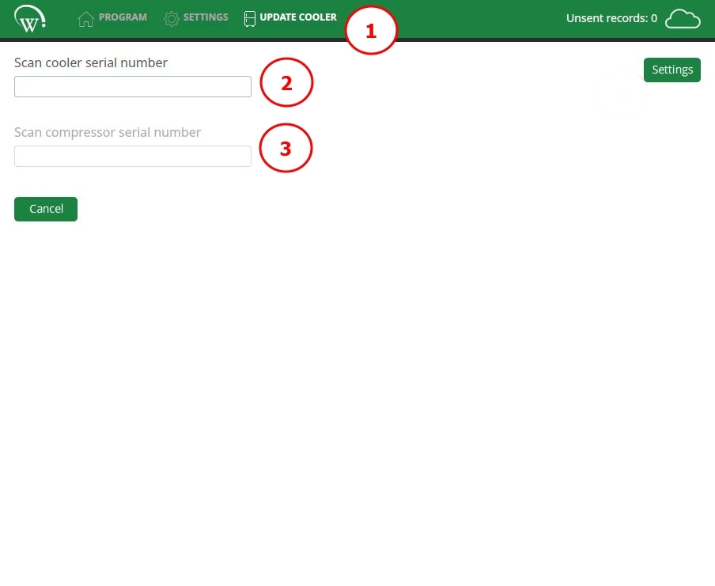
Update cooler screen – 5 of 5
Navigate to UPDATE COOLER tab.
Scan equipment serial number.
Scan compressor serial number.

Slide 54
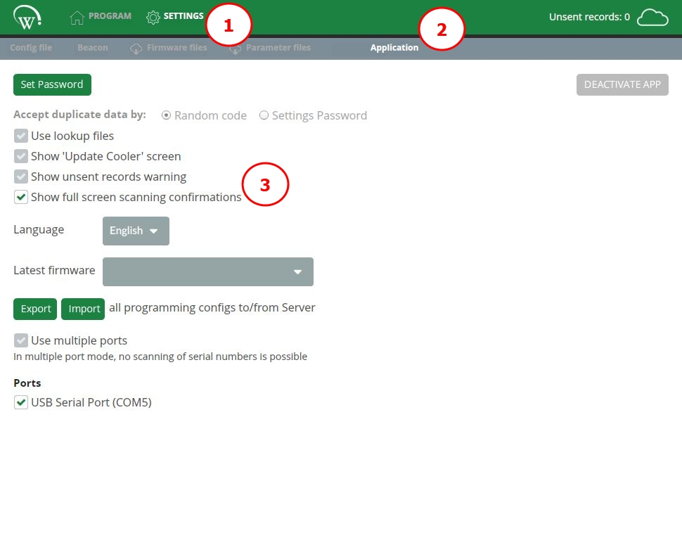
Full screen scanning confirmations – 1 of 2
When running production, there is the frequent need to validate scanning and programming from a distance. Cradle Programmer provides the full screen scanning confirmation feature to increase visibility from afar.
Part 1: Enable full screen scanning confirmations
Navigate to the SETTINGS tab.
Access the APPLICATION submenu.
Select SHOW FULL SCREEN SCANNING CONFIRMATIONS tick box.
This setting impacts both the update cooler screen and the programming screen. When selected, both screens will show full screen confirmations.

Slide 55
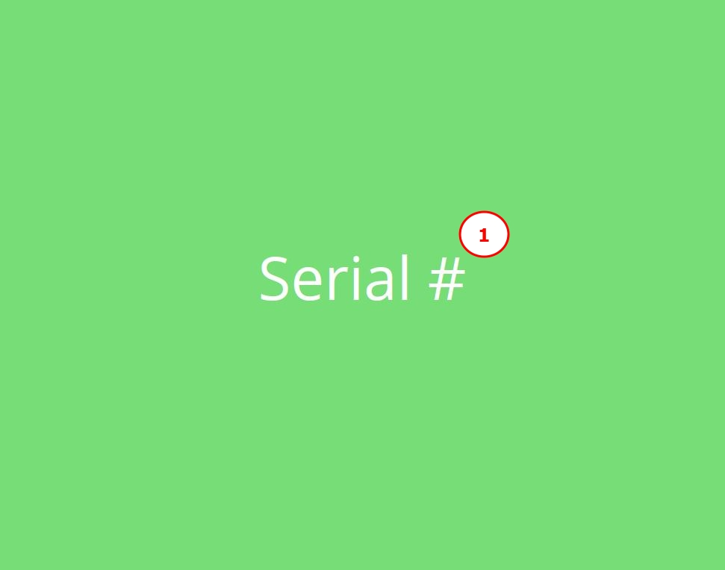
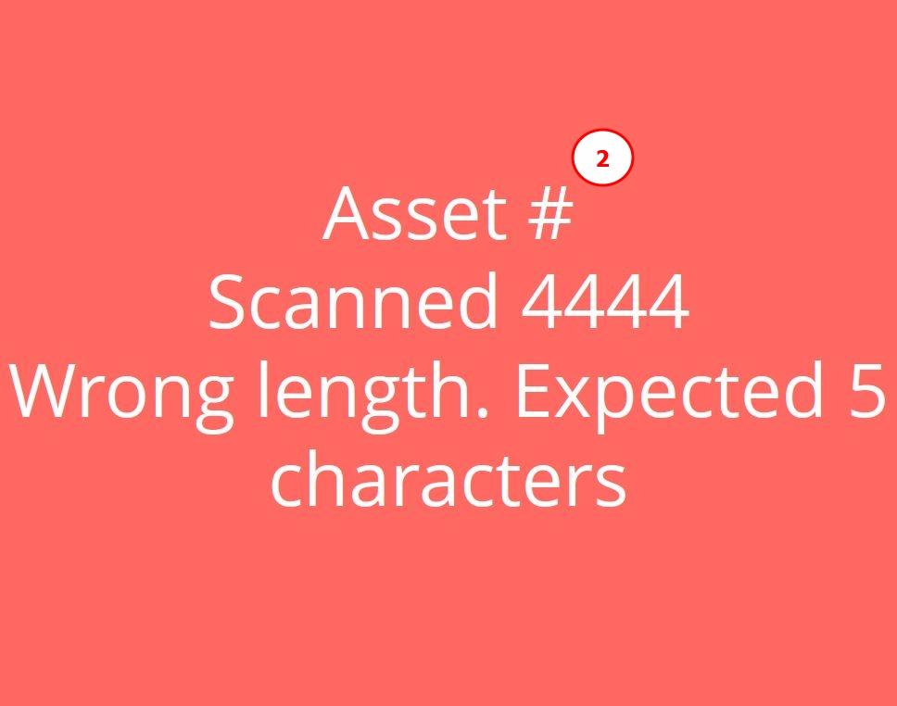
Full screen scanning confirmations – 2 of 2
Part 2: Full screen confirmation types
A GREEN SCREEN indicates a successful scan, with the field being indicated.
A RED SCREEN represents an unsuccessful scan, meaning that there was a read error, or that the specified validation rules have not been met with the fault being indicated.

Slide 56
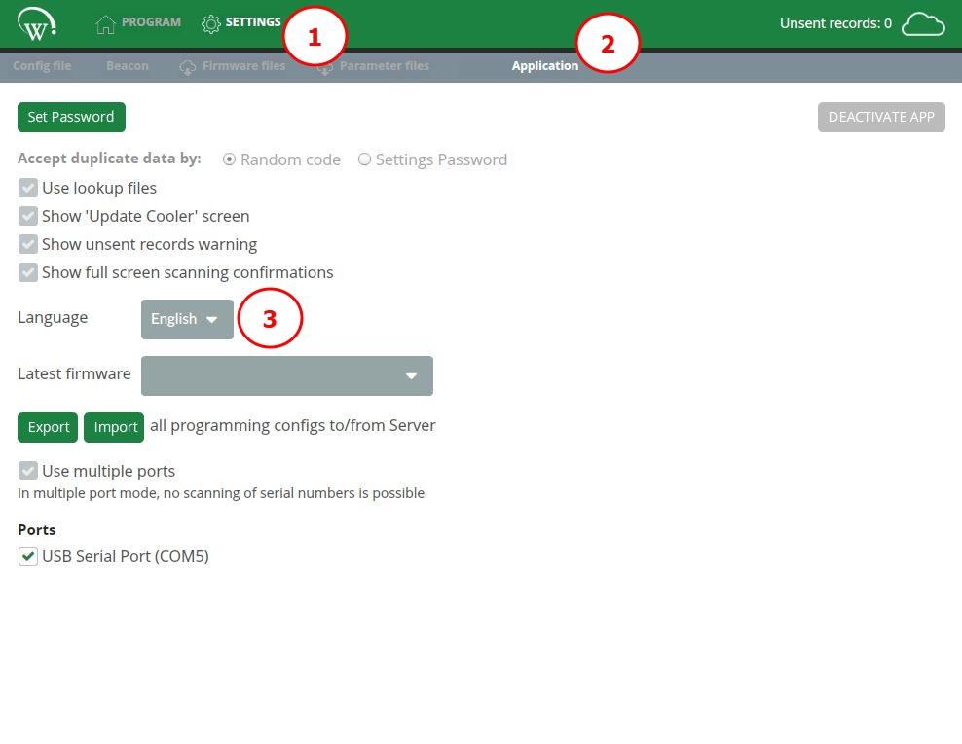
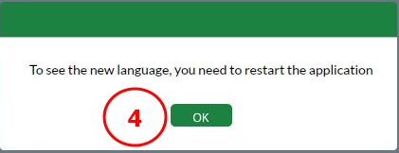
Language settings
The Cradle Programmer supports the following languages listed below:
English
Spanish
Portuguese
Turkish
Selecting the language
Navigate to the SETTINGS tab.
Access the APPLICATION submenu.
Select desired language from the LANGUAGE drop-down box.
Select OK and RESTART THE APPLICATION for the language to change.

Slide 57
Export / Import programming configurations – 1 of 5
The Cradle Programmer allows exporting and importing of configuration files and lookup files between local storage (in the PC/Laptop) and the AoFrio Cloud (server).
This feature is important when configuration files and lookup files are generated by a research and development team or lab technicians and stored on the server to then be locally saved in the PC/Laptop used in the production line.
It is recommended that only the necessary files be made available for each production line, contributing to reduce potential for errors and confusion at the time of programming.
IMPORT will overwrite all lookup file and configuration file settings currently saved to local storage (PC/Laptop) with the version imported from the Cloud (server).
EXPORT will overwrite all lookup file and configuration file settings currently saved to the Cloud (server) with the version exported from the local storage.
The ability to import/export configuration files and lookup files is only available to users with login access to the AoFrio system, as Cloud authentication is password-protected. Please contact your organization’s user manager for permissions, or your AoFrio representative for support and additional information.

Slide 58
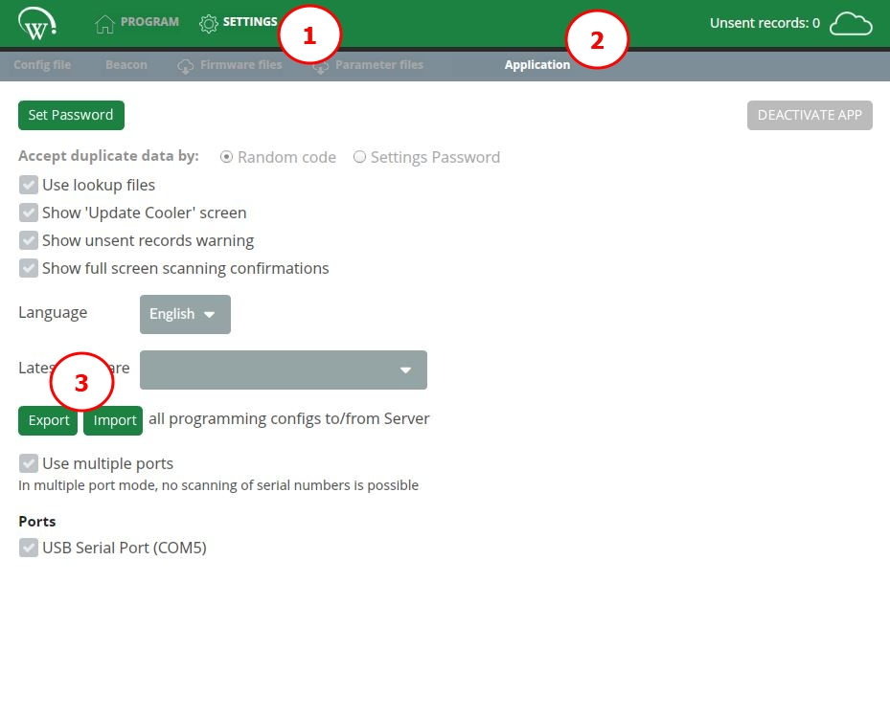
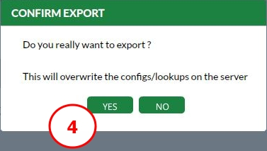
Export / Import programming configurations – 2 of 5
Exporting files
The export feature allows the upload of lookup and configuration files FROM local storage TO the server.
Navigate to the SETTINGS tab.
Access the APPLICATION submenu.
Select EXPORT.
Select YES to EXPORT CONFIGS to the server and overwrite the current setup.

Slide 59


Export / Import programming configurations – 3 of 5
Use your credentials to authenticate with the AoFrio Cloud (server) and click LOGIN.
Select OK to acknowledge the EXPORT SUCCESS message.
Once files are successfully uploaded to the AoFrio Cloud (server), any PC/Laptop equipped with the Cradle Programmer can IMPORT the configurations and make them locally available.

Slide 60

Export / Import programming configurations – 4 of 5
Importing files
The import feature allows the download of lookup and configuration files FROM the server TO local storage.
A file containing all lookup and configuration files must be previously uploaded to the server using the EXPORT feature for the IMPORT to be successful.
Navigate to the SETTINGS tab.
Access the APPLICATION submenu.
Select IMPORT.

Slide 61


Export / Import programming configurations – 5 of 5
Select YES to IMPORT CONFIGS from the server and overwrite the current setup.
Select OK to acknowledge the IMPORT WAS SUCCESSFUL message.

Slide 62
Batch programming – 1 of 2
The programming process can be implemented in two different ways: batch or in-line (default).
In-line programming | Recommended when controllers are programmed in final assembly, when they are associated with a specific equipment unit. In-line process is recommended to ensure asset number information is written to the controller. Only one controller can be programmed at a time (single USB port supported) to ensure the scanned serial number and/or asset number is/are written to the correct controller.
Batch programming | Recommended when controllers have some information pre-programmed to speed up the final assembly process. If necessary to use batch programming, please speak to your AoFrio representative. There are several consequences and processes that must be discussed. The exact same parameters, firmware, manufacturer, owner, brand, and model are programmed against multiple controllers. This process does NOT allow programming of identifiers that are unique to the individual equipment, such as the asset number, equipment serial number, or compressor serial number. Up to four controllers can be programmed at the same time (multiple USB ports supported)

Slide 63

Batch programming – 2 of 2
Enable batch programming
Navigate to the SETTINGS tab.
Access the APPLICATION submenu.
Select USE MULTIPLE PORTS tick box.
Select the applicable PORTS by marking the tick boxes.
Scanning of serial number, asset number, and compressor serial number is disabled in batch programming mode.
When using batch programming, ensure to use configuration files or lookup files that do not require scanning of unique identifiers (asset number, equipment serial number, compressor serial number), otherwise programming errors may occur.

Slide 64

Deactivation
The Cradle Programmer may be deactivated at any time. However, this will no longer allow AoFrio SCS controllers to be manufactured until the application is reactivated, which requires entering an activation code, per installation and activation instructions in this manual.
Deactivating the Cradle Programmer will NOT clear out information kept in the local storage (such as configuration files, lookup files, parameter files, firmware files). If the Cradle Programmer is reactivated on the PC/Laptop with the same activation code previously used, all locally saved settings will be restored.
Navigate to the SETTINGS tab.
Access the APPLICATION submenu.
Select DEACTIVATE APP.

Slide 65
Troubleshooting
Issue | Actions
Cradle Programmer does not detect controller | Check set to RUN, not STOP. Check correct port has been selected for programming. Remove controller, try inserting again.
Desired owner is not available in the drop-down list | Owner company has not been associated with your company. Please contact your AoFrio representative to create the required link.
Parameter file is not visible | Check internet connection. Check file has been created and uploaded to the AoFrio Cloud. Check the file is in “released” status, not “draft”.

Slide 66
Cradle Programmer
Glossary of terms

Slide 67
Glossary of terms
Term | Definition
Asset number | The unique identifier for the equipment. This information is recorded into the controller and must be unique.
Brand | A classification within the AoFrio IoT system that enables the Owner to create a categorization for its equipment. Leads to data subdivision within the system.
Compressor serial number | The unique identifier for the compressor unit installed into the equipment. It can be associated with the controller to improve component control for the equipment Owner and/or Manufacturer.
Configuration file | A master file containing all information required to program a controller. Intended to facilitate selection during production, it can be made to manage specific equipment model, owner, firmware version, etc.
Cradle Programmer | The software component that enables programming and configuration of AoFrio SCS controller in the equipment manufacturing facility, as well as controls ownership associations.
Equipment serial number | A series of characters used to uniquely identify equipment and is often electronically embedded by the manufacturer.
Factory default parameters | The set of parameters that comes installed in the controller from the AoFrio factory.
Firmware file | A specific version of the software that provides the low-level control for the hardware in the specific controller. Controls the features and functionality available.
Latest firmware | The most up to date and recently released version of the firmware.

Slide 68
Glossary of terms
Term | Definition
Lookup file | A delimited file that contains configurations for a controller and that responds to specific information being entered or scanned into the user interface of the Cradle Programmer.
Manufacturer | The company responsible for manufacturing or assembling the equipment in which AoFrio components are installed. Also called “OEM” or “original equipment manufacturer” or “supplier”.
Operator | The staff working on equipment production lines, whether manufacturing or final assembly.
Owner | The company who purchases and manages the equipment for its entire lifecycle, frequently called “bottler”.
Parameter file | A file that contains a list of initialization information and a value for each parameter that controls the equipment.
Programming screen | A screen that provides user with information about the programming process of a specific controller.
Server | The AoFrio Cloud, where information is centrally stored online to be accessible to all authorized users of a specific database.
Supervisor | The person responsible for supervision of the manufacturing and assembly activities.
Update cooler screen | A screen that gives the opportunity for additional information to be inputted once the controller has been programmed.
User Manager | A separate digital tool in the AoFrio IoT ecosystem that is used by customers to control and manage access to their database and other tools in the system.

Slide 69
Thank you!

